Slide 1
Weakly Supervised Segmentation via Class Activation Mapping
Huangzhao Zhang, zhang_hz@pku.edu.cn

Slide 2
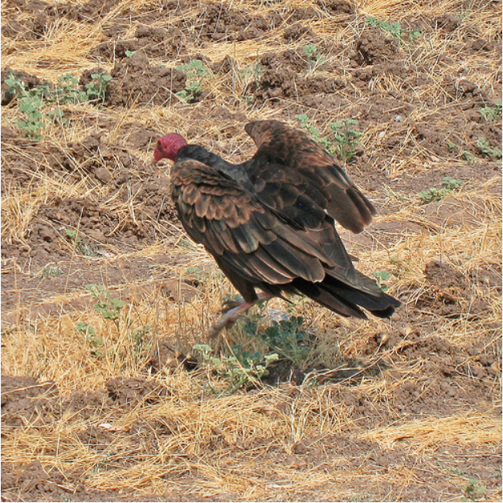

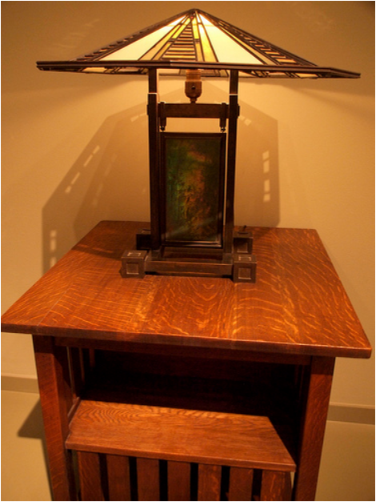
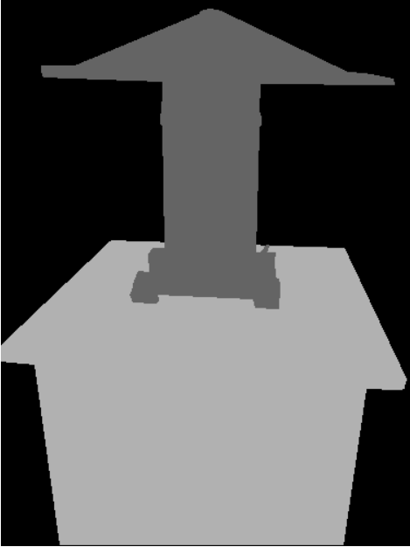
Weakly Supervised Segmentation
Semantic segmentation
Weakly supervised semantic segmentation
Training – images + classification labels
Evaluation – images + pixel labels

Slide 3
Weakly Supervised Segmentation (2)
CVPR’20 LID Track 1
LID – Learning from imperfect data
ILSVRC dataset (ImageNet) – 200 categories; multi-classification
Training set – 456567 images + classification labels
Dev set – 5000 images + segmentation labels
Test set – 10000 images + segmentation labels
Evaluation metric
Mean IoU (intersection over union) over 200 categories

Slide 4
Weakly Supervised Localization
Task – Defect localization, pattern recognition, etc.
Dataset
Classification – Easy to label
Localization – Extremely hard to label
Understanding NN
How do NNs make prediction?
Why do NNs produce erroneous results?

Slide 5
Overview
Weakly Supervised Segmentation
Global Average Pooling (GAP)
Class Activation Mapping (CAM)
Multi-dilated Convolution
Gradient-weighted Class Activation Mapping (Grad-CAM)
CAM for RNN

Slide 6


Slide 7
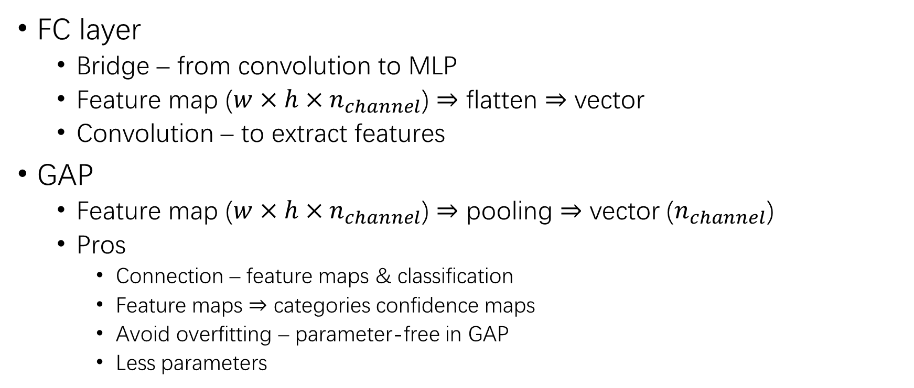
Global Average Pooling
FC layer
Bridge – from convolution to MLP
Feature map ($w×h×n_{channel}$) $⇒$ flatten $⇒$ vector
Convolution – to extract features
GAP
Feature map ($w×h×n_{channel}$) $⇒$ pooling $⇒$ vector ($n_{channel}$)
Pros
Connection – feature maps & classification
Feature maps $⇒$ categories confidence maps
Avoid overfitting – parameter-free in GAP
Less parameters

Slide 8
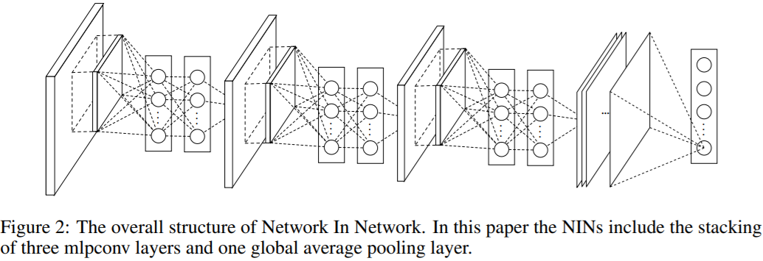
Network in Network

Slide 9
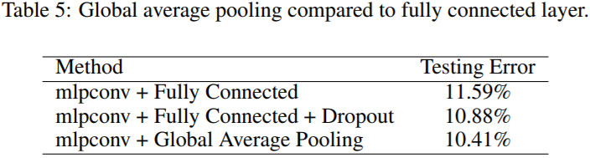
GAP vs. FC

Slide 10
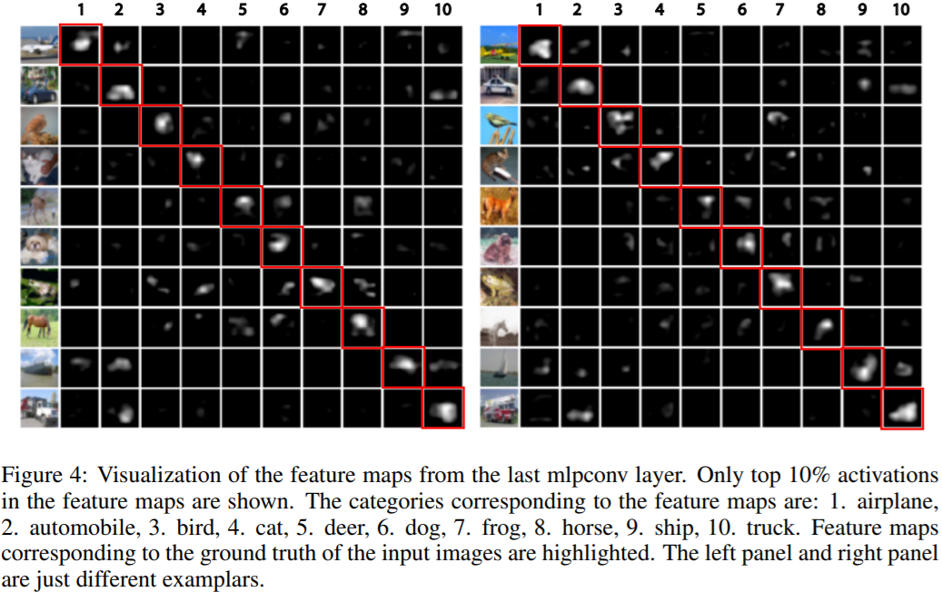
GAP Visualization

Slide 11
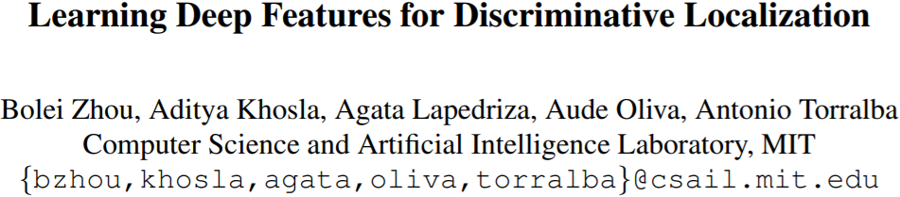

Slide 12
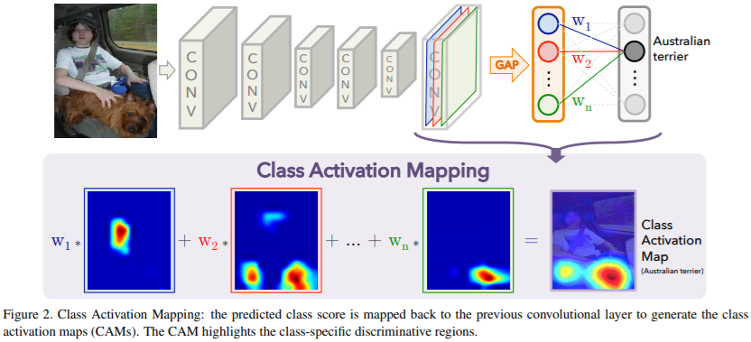
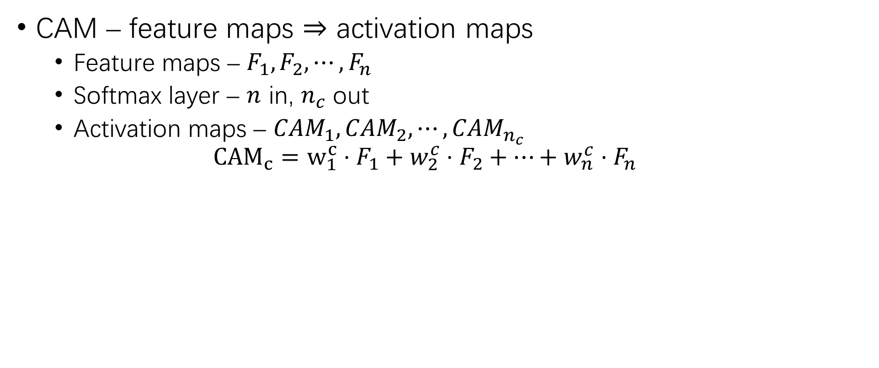
Class Activation Mapping
CAM – feature maps $⇒$ activation maps
Feature maps – $F_{1},F_{2},⋯,F_{n}$
Softmax layer – $n$ in, $n_{c}$ out
Activation maps – ${CAM}_{1},{CAM}_{2},⋯,{CAM}_{n_{c}}$
$${CAM}_{c}=w_{1}^{c}⋅F_{1}+w_{2}^{c}⋅F_{2}+⋯+w_{n}^{c}⋅F_{n}$$

Slide 13
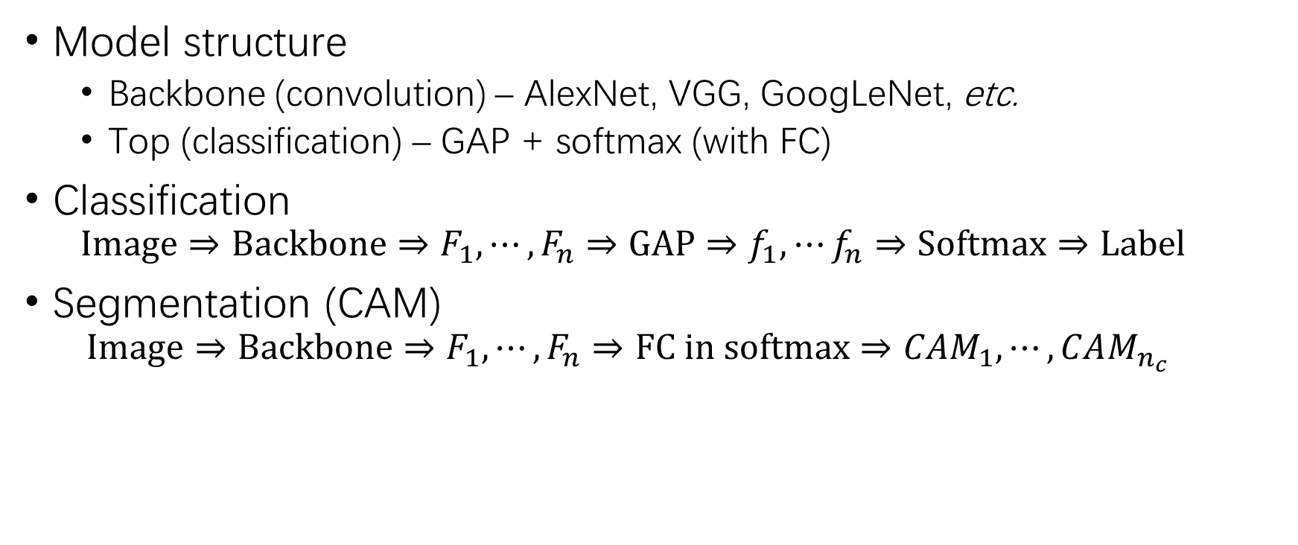
Class Activation Mapping (2)
Model structure
Backbone (convolution) – AlexNet, VGG, GoogLeNet, etc.
Top (classification) – GAP + softmax (with FC)
Classification
$$Image⇒Backbone⇒F_{1},⋯,F_{n}⇒GAP⇒f_{1},⋯f_{n}⇒Softmax⇒Label$$
Segmentation (CAM)
$$Image⇒Backbone⇒F_{1},⋯,F_{n}⇒FC in softmax⇒CAM_{1},⋯,CAM_{n_{c}}$$

Slide 14
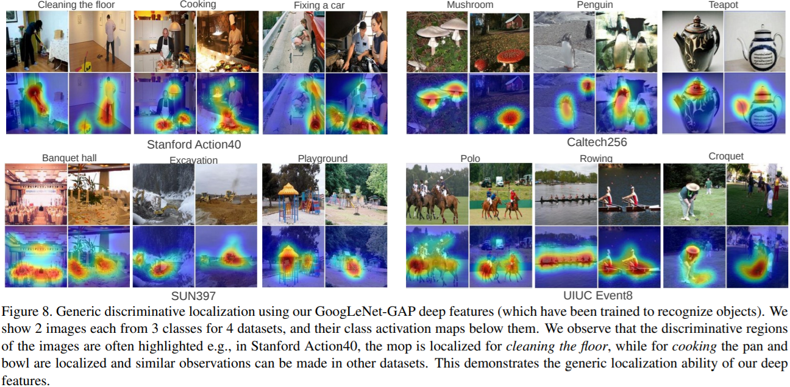
CAM Visualization

Slide 15
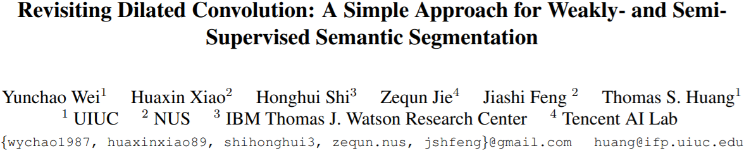

Slide 16
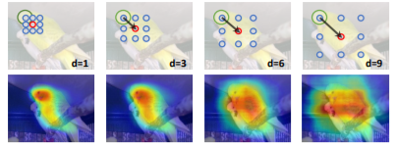

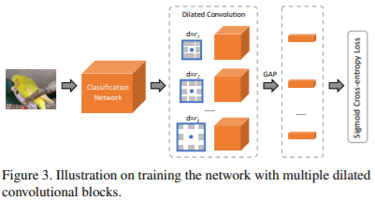
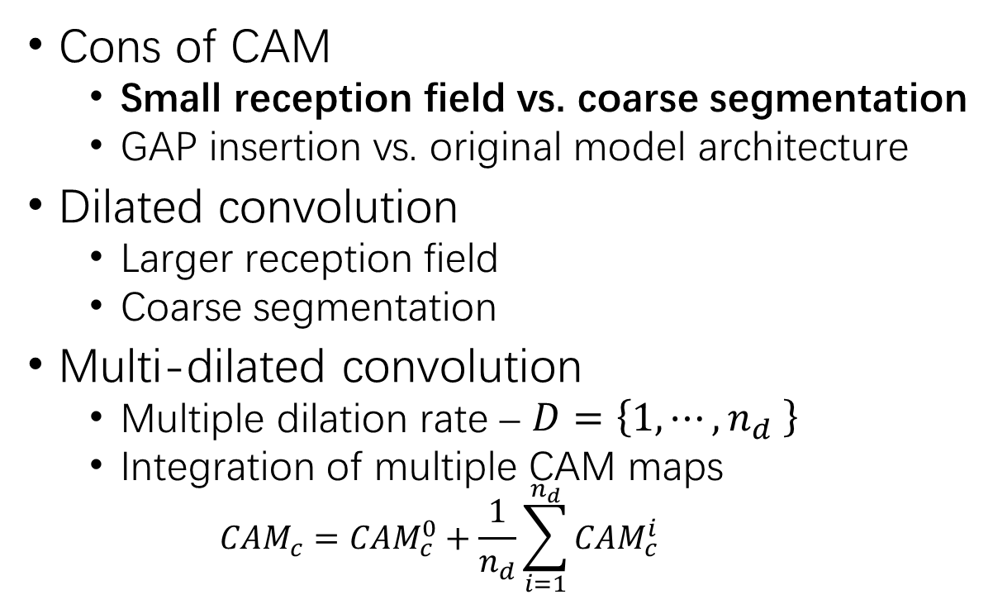
Multi-dilated Convolution
Cons of CAM
Small reception field vs. coarse segmentation
GAP insertion vs. original model architecture
Dilated convolution
Larger reception field
Coarse segmentation
Multi-dilated convolution
Multiple dilation rate – $D=\left\{1,⋯,n_{d} \right\}$
Integration of multiple CAM maps
$$CAM_{c}=CAM_{c}^{0}+\frac{1}{n_{d}}\sum_{i=1}^{n_{d}}{CAM_{c}^{i}}$$

Slide 17
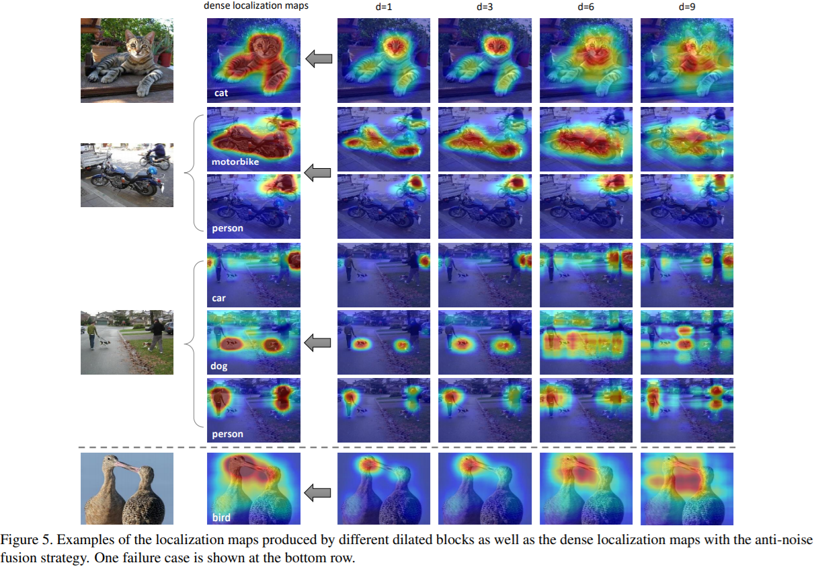

Slide 18
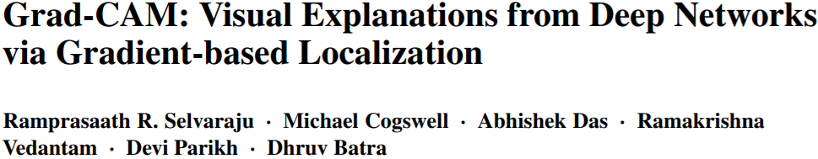

Slide 19
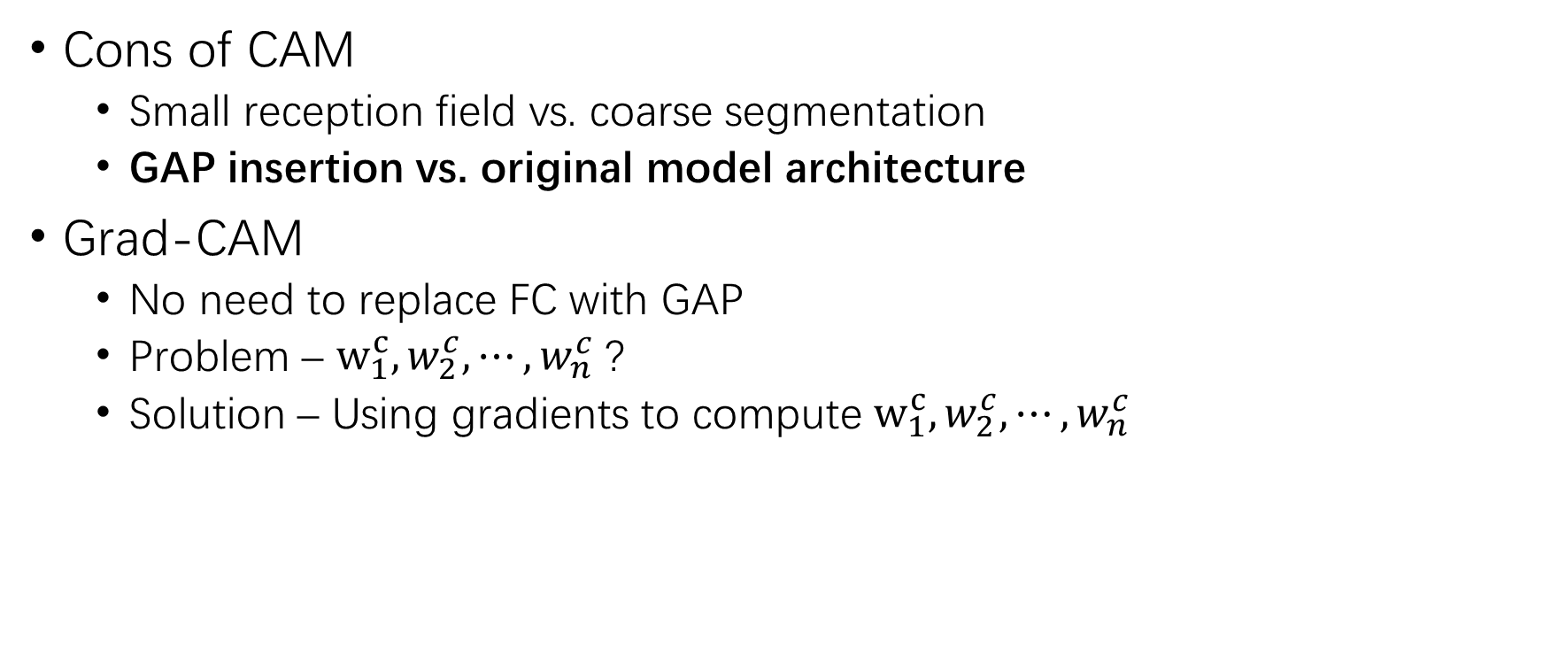
Gradient-weighted CAM
Cons of CAM
Small reception field vs. coarse segmentation
GAP insertion vs. original model architecture
Grad-CAM
No need to replace FC with GAP
Problem – $w_{1}^{c},w_{2}^{c},⋯,w_{n}^{c}$ ?
Solution – Using gradients to compute $w_{1}^{c},w_{2}^{c},⋯,w_{n}^{c}$

Slide 20
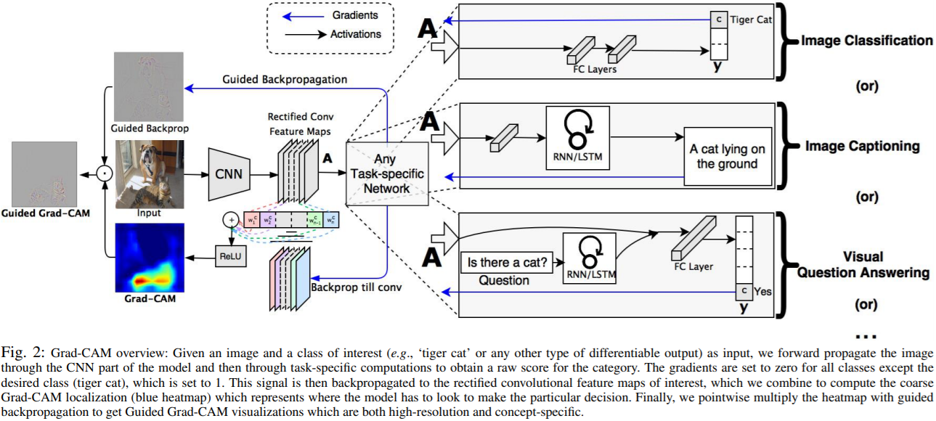

Slide 21
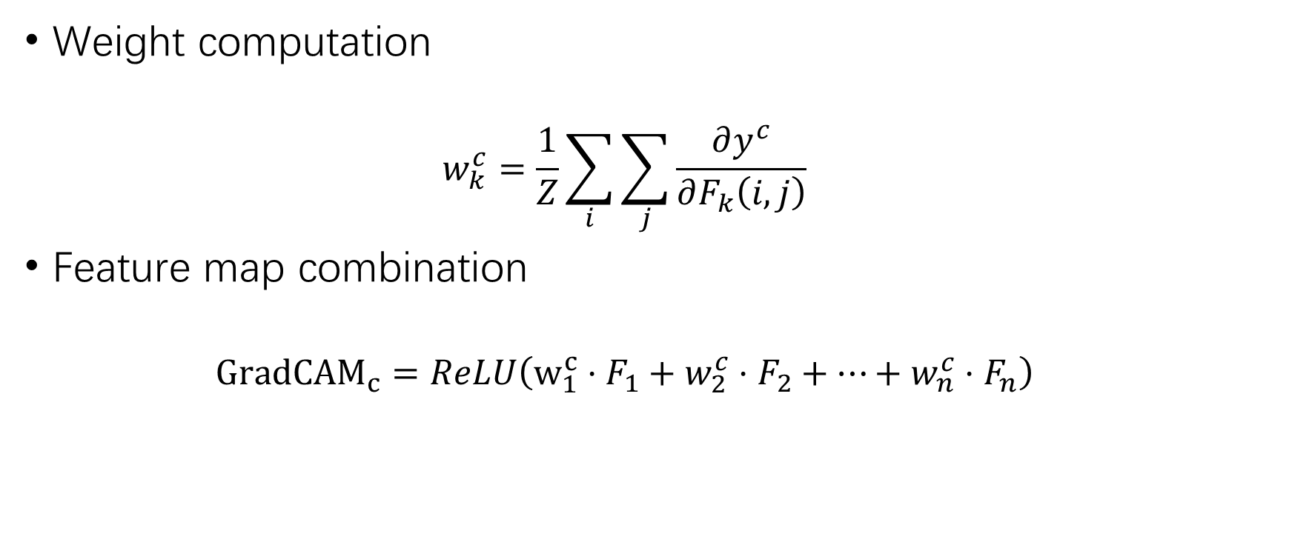
Gradient-weighted CAM (2)
Weight computation
$$w_{k}^{c}=\frac{1}{Z}\sum_{i}{\sum_{j}{\frac{∂y^{c}}{∂F_{k}\left(i,j\right)}}}$$
Feature map combination
$${GradCAM}_{c}=ReLU\left(w_{1}^{c}⋅F_{1}+w_{2}^{c}⋅F_{2}+⋯+w_{n}^{c}⋅F_{n}\right)$$
GAP
CAM

Slide 22
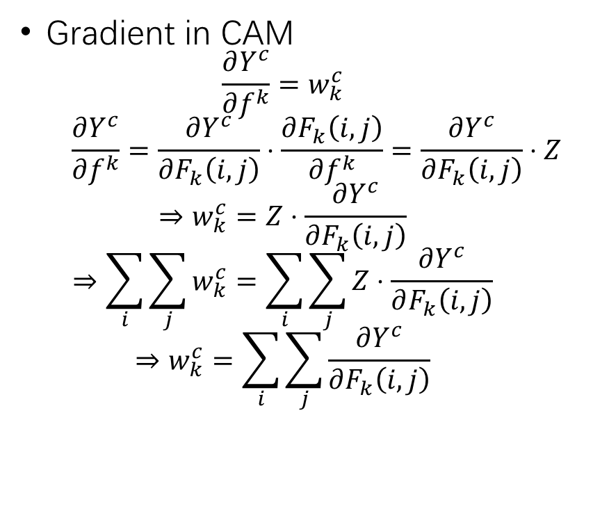
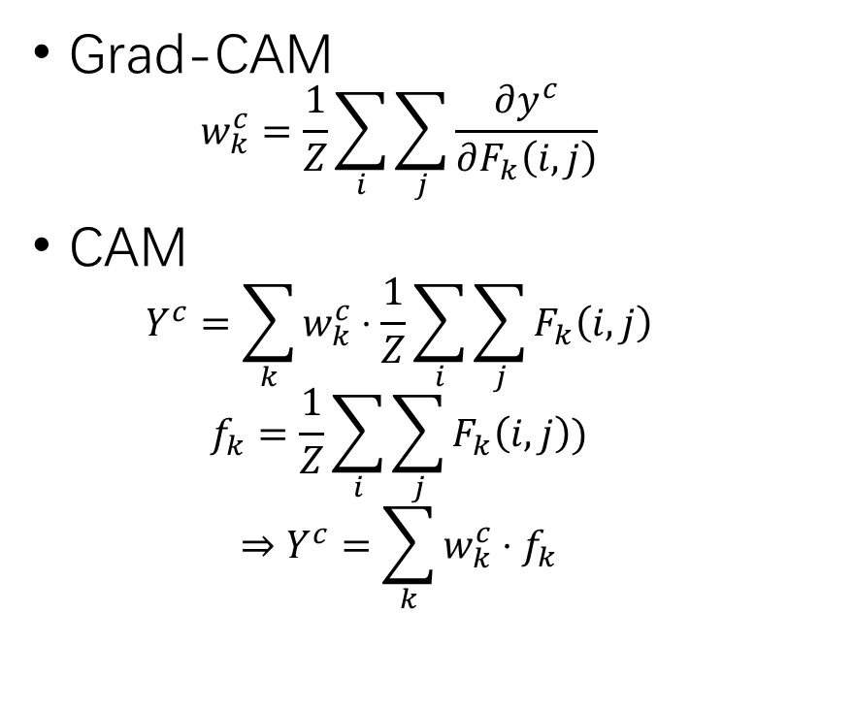
Grad-CAM vs. CAM
Grad-CAM
$$w_{k}^{c}=\frac{1}{Z}\sum_{i}{\sum_{j}{\frac{∂y^{c}}{∂F_{k}\left(i,j\right)}}}$$
CAM
$$Y^{c}=\sum_{k}{w_{k}^{c}⋅\frac{1}{Z}\sum_{i}{\sum_{j}{F_{k}\left(i,j\right)}}}$$
$$f_{k}=\frac{1}{Z}\sum_{i}{\sum_{j}{F_{k}\left(i,j\right)}})$$
$$⇒Y^{c}=\sum_{k}{w_{k}^{c}⋅f_{k}}$$
Gradient in CAM
$$\frac{∂Y^{c}}{∂f^{k}}=w_{k}^{c}$$
$$\frac{∂Y^{c}}{∂f^{k}}=\frac{∂Y^{c}}{∂F_{k}\left(i,j\right)}⋅\frac{∂F_{k}\left(i,j\right)}{∂f^{k}}=\frac{∂Y^{c}}{∂F_{k}\left(i,j\right)}⋅Z$$
$$⇒w_{k}^{c}=Z⋅\frac{∂Y^{c}}{∂F_{k}\left(i,j\right)}$$
$$⇒\sum_{i}{\sum_{j}{w_{k}^{c}}}=\sum_{i}{\sum_{j}{Z⋅\frac{∂Y^{c}}{∂F_{k}\left(i,j\right)}}}$$
$$⇒w_{k}^{c}=\sum_{i}{\sum_{j}{\frac{∂Y^{c}}{∂F_{k}\left(i,j\right)}}}$$

Slide 23
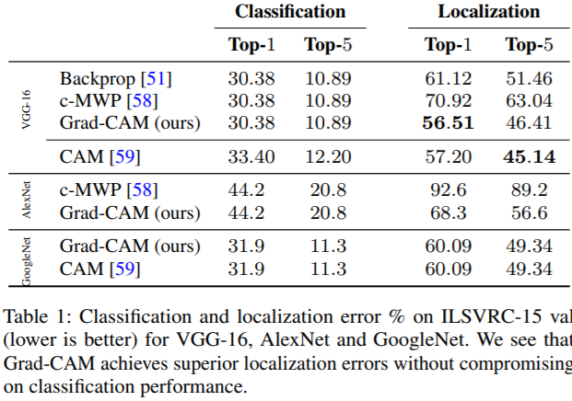
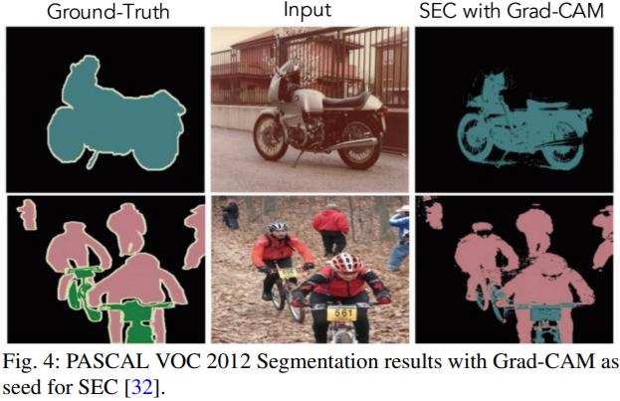
Weakly Supervised Segmentation

Slide 24
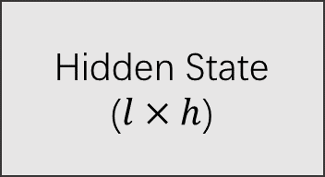
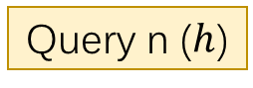
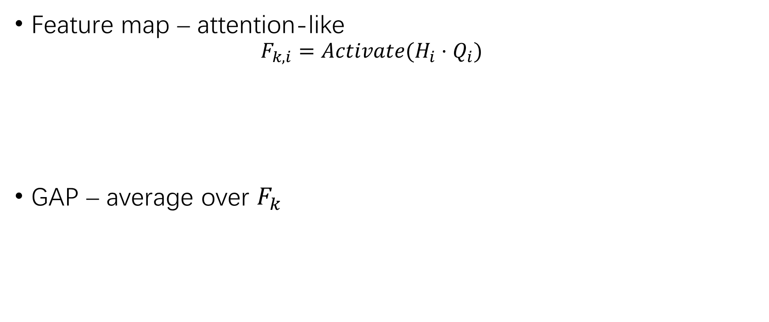

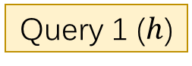

RNN CAM
Feature map – attention-like
$$F_{k,i}=Activate(H_{i}⋅Q_{i})$$
GAP – average over $F_{k}$
Query 1 ($h$)
Hidden State
($l×h$)
$F_{1}$ ($l$)
Query n ($h$)
…
$F_{n}$ ($l$)

Slide 25
THANK YOU!

